Slide 1
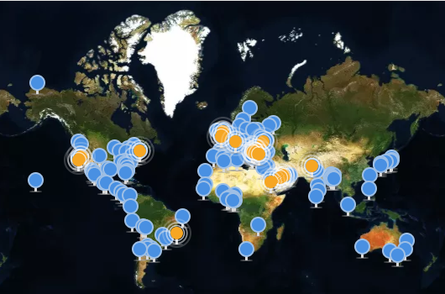

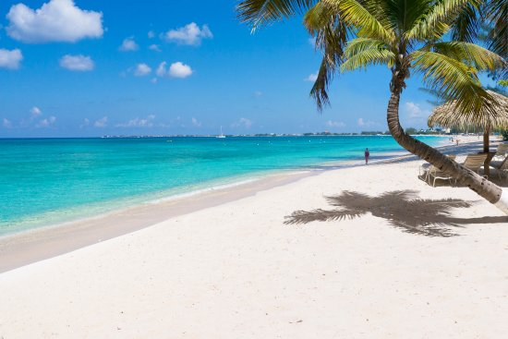
Beach Trip Helper Team NCTUBeach: Hung Hung Wei, Huang Tzu Ming, Lee Chi Ming 2017/04/30

Slide 2

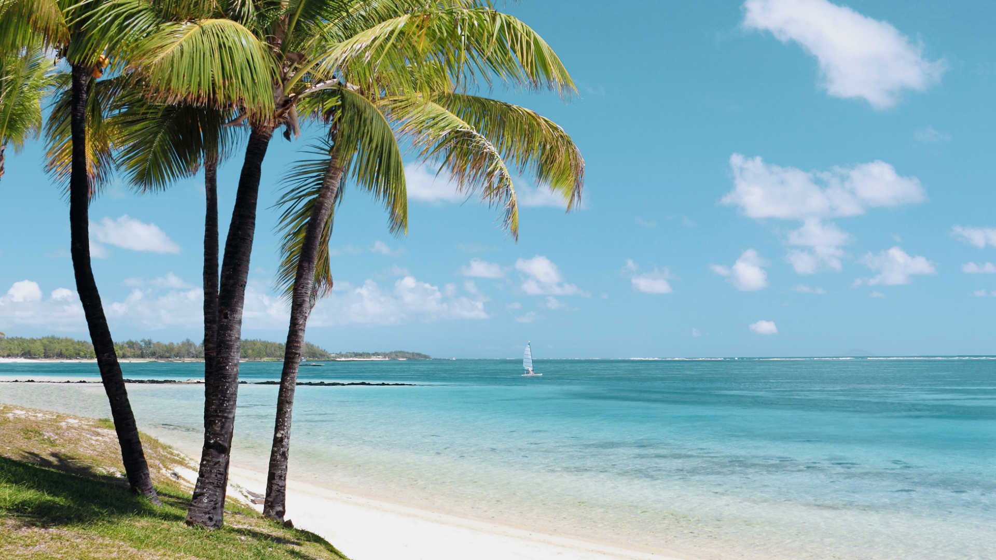
Let’s go to the Beach!
一起去海邊！

Slide 3
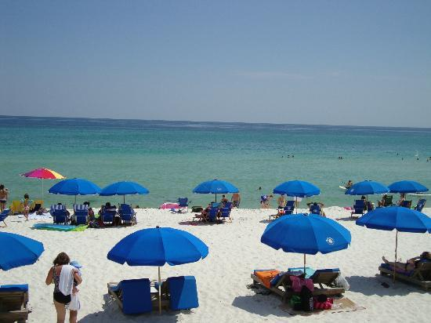
Background
According to the World Health Organization, overexposure to sunlight can cause harm to our skin, our eyes, and our immune systems due to UV damage.
On the other hand, some algae can produce toxins that cause rashes, breathing problems, and liver damage.
The rise in the accident of above two causes over the past decades is strongly related to increasingly popular outdoor activities and recreational exposure.

Slide 4
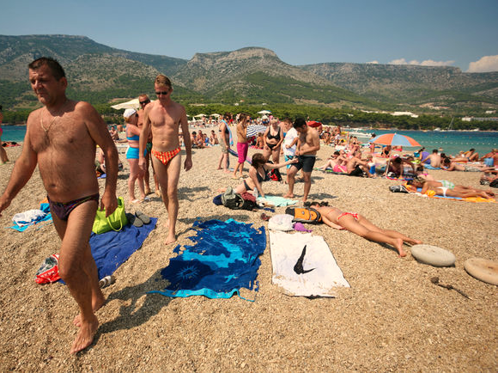
Problem Definition
Playing around beaches, beach-goers are at the risk of HIGH LEVEL of UV RADIATION EXPOSURE and TOXIC ALGAE.
Notes:
Source: Retrieved April 29, 2017, from https://www.google.com.tw/search?safe=off&biw=1366&bih=613&tbm=isch&sa=1&q=beach+goers&oq=beach-goer&gs_l=img.3.0.0i30k1l3.8788.14995.0.16400.12.12.0.0.0.0.55.520.12.12.0....0...1c.1.64.img..0.12.518...0j35i39k1j0i19k1j0i30i19k1j0i5i30i19k1j0i8i30i19k1j0i10i19k1j0i7i30i19k1.H1KqncOcDY8#imgrc=xfLtXWrK2huZfM:

Slide 5
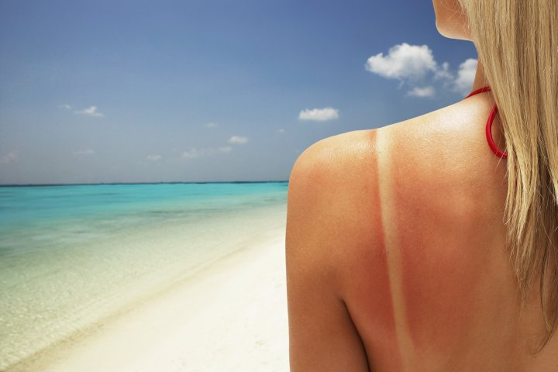
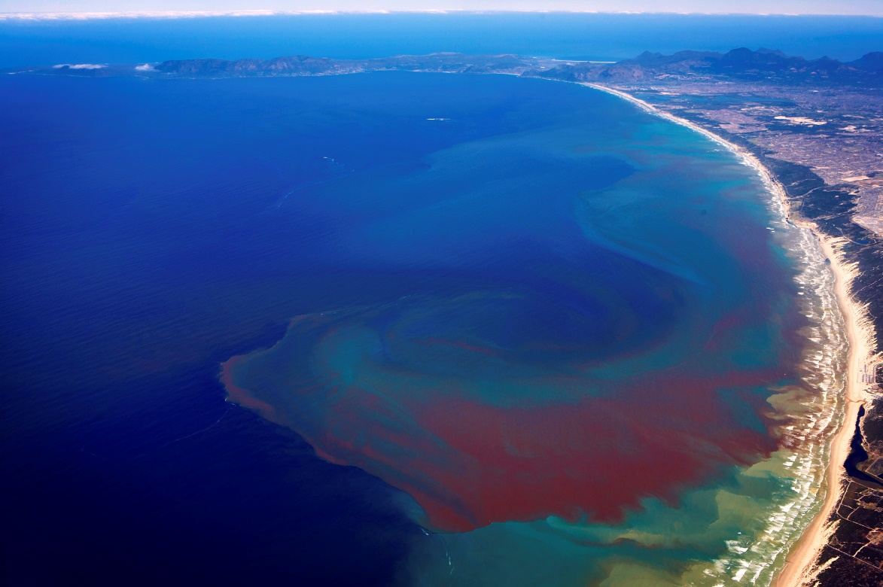
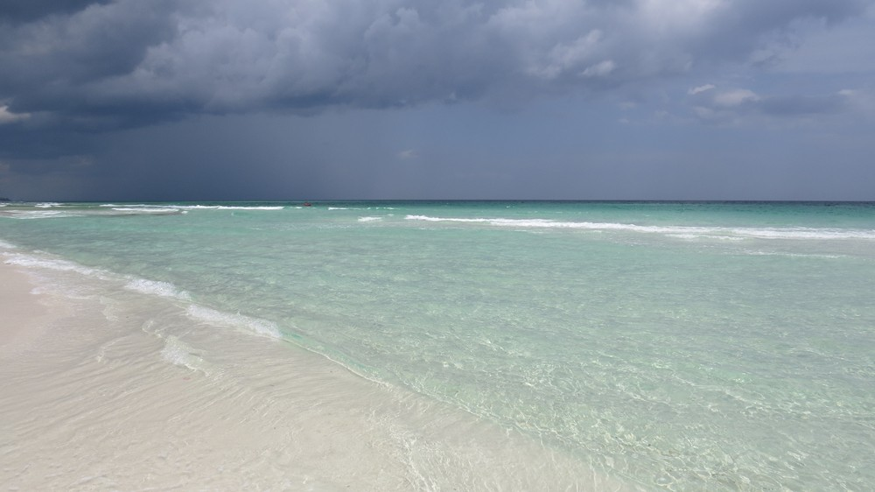
Scenarios
Sun Burn
Algae Blooms
Tide about to rise
About to rain

Slide 6
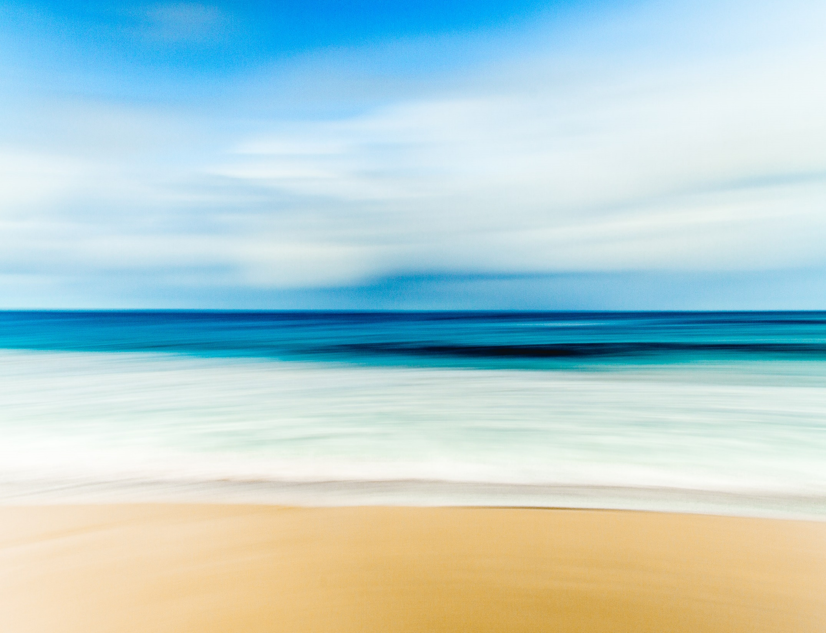


An Idea – Solution
Solution - APP
Problem
Beach Trip Helper
High Level of UV Radiation and toxic algae can cause Impacts on Human Health.
Decision Support
Science Knowledge
Short Reminder
Warning Functions
Rain Warnings
Tide Warnings
Input Data
$IBM {Bluemix}^{TM}$
$NASA MODIS DATA$
$World Tides$
Notes:
Icon citation:
Source: Retrieved April 29, 2017, from http://www.iconarchive.com/show/kameleon.pics-icons-by-webalys/Beach-icon.html
除了主要目的UV過量警示與有毒藻類警示外，其他像是天氣預報、科學小知識等功能，都有提供給使用者。

Slide 7
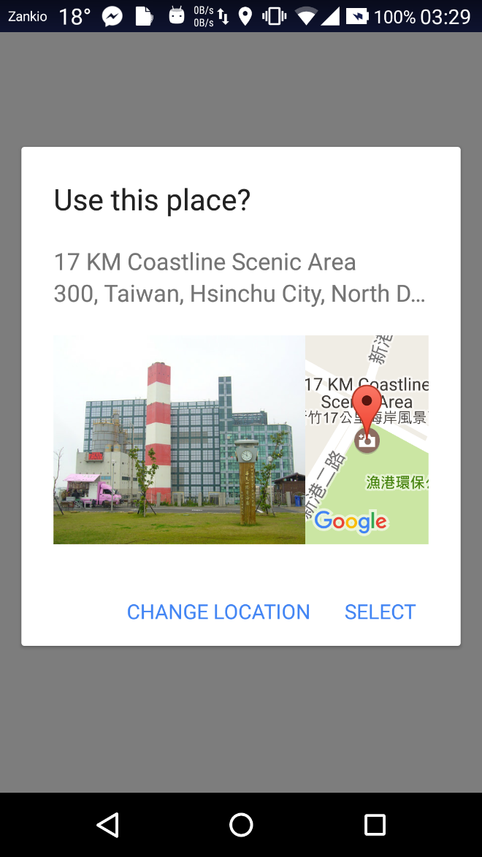
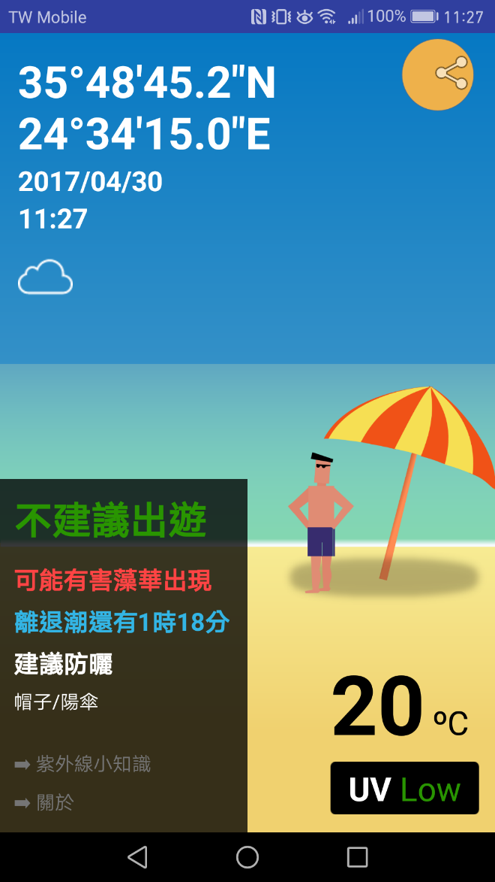
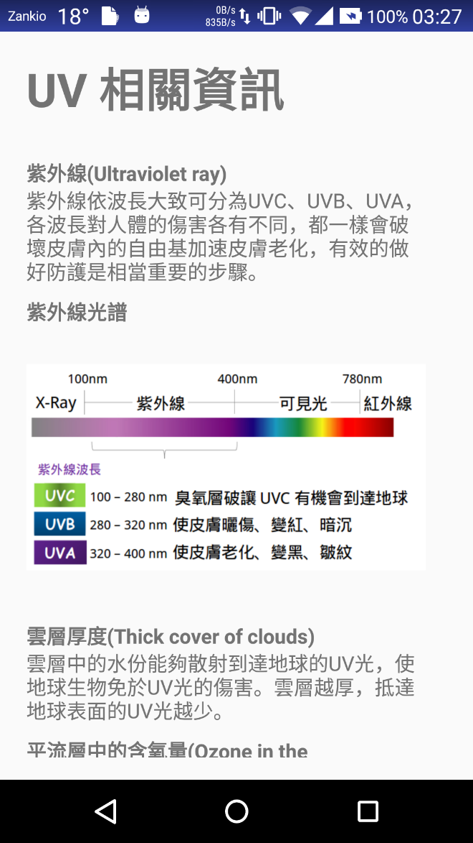
User Interface
Location Identification
Suggestions & Reminders
Science Knowledge

Slide 8
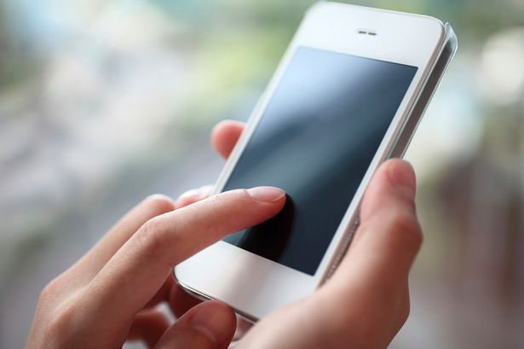
Demonstration

Slide 9
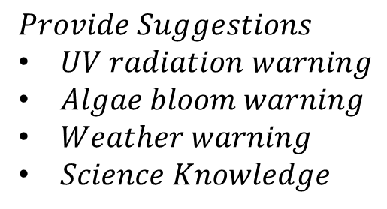
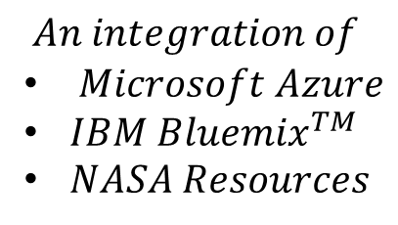
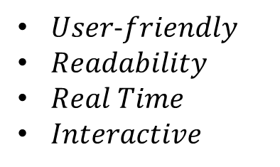

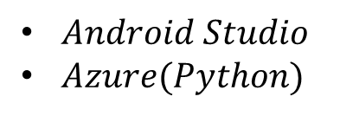
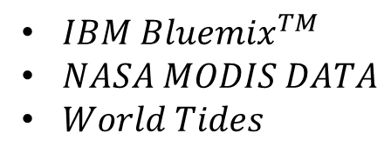
Solution Details
Data Collection
Application Development
Problem Definition
$Public Awareness$
$IBM {Bluemix}^{TM}$
$NASA MODIS DATA$
$World Tides$
$Android Studio$
$Azure(Python)$
Platform Integration
Solution
Software Optimization
$$An integration of$$
$Microsoft Azure$
$IBM{ Bluemix}^{TM}$
$NASA Resources$
$User$-$friendly$
$Readability$
$Real Time$
$Interactive$
$$Provide Suggestions$$
$UV radiation warning$
$Algae bloom warning$
$Weather warning$
$Science Knowledge$

Slide 10
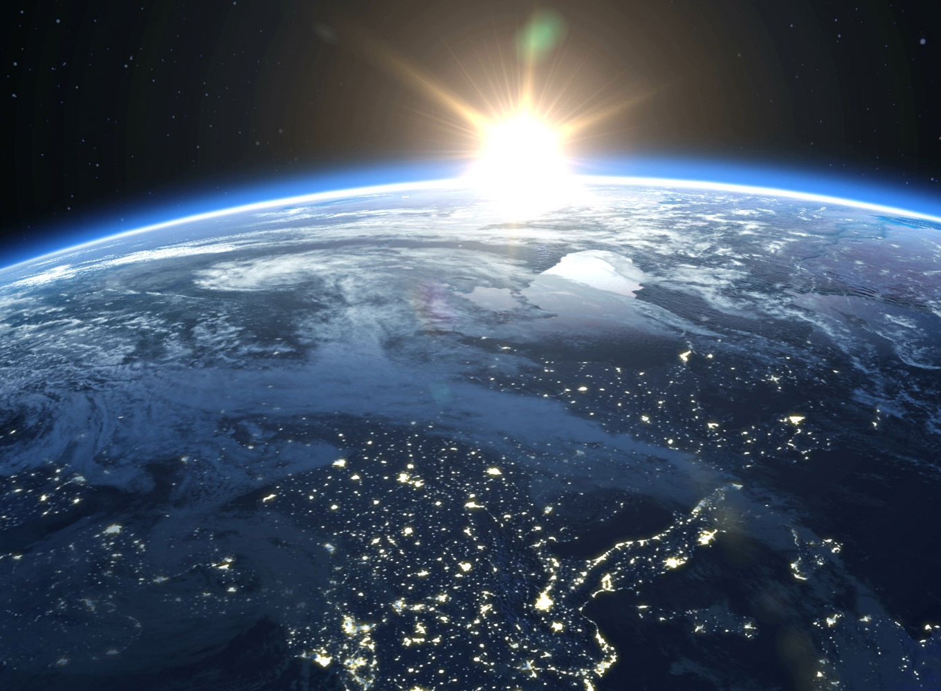
The Future
Beach Trip Helper will prevent more accidents caused by high level of UV radiation and harmful algae bloom.
Games can be added to make informative science knowledge more accessible.

Slide 11
References
Challenge: https://www.google.com.tw/search?q=Beach&safe=off&tbm=isch&source=lnt&tbs=isz:l&sa=X&ved=0ahUKEwiYkNXYgsrTAhXJUbwKHaKTDtkQpwUIGw&biw=1366&bih=613&dpr=1#imgrc=EGN2oP1MTxHVnM:
Problem definition https://www.google.com.tw/search?safe=off&biw=1366&bih=613&tbm=isch&sa=1&q=beach+goers&oq=beach-goer&gs_l=img.3.0.0i30k1l3.8788.14995.0.16400.12.12.0.0.0.0.55.520.12.12.0....0...1c.1.64.img..0.12.518...0j35i39k1j0i19k1j0i30i19k1j0i5i30i19k1j0i8i30i19k1j0i10i19k1j0i7i30i19k1.H1KqncOcDY8#imgrc=xfLtXWrK2huZfM:
Scenarios: https://www.bing.com/images/search?view=detailV2&ccid=Un8FIQJh&id=77ED13D667E1A6EF12E048F6F3C12D7EB0BA1366&thid=OIP.Un8FIQJhJsbl82sSAmv5ngEsCo&q=rainy+beach&simid=608006128901423496&selectedIndex=19&ajaxhist=0
https://www.bing.com/images/results.aspx?q=red+tide&FORM=DLCBLB&PC=MDDC&MKT=en-us#view=detail&id=0137099425274A2C2FF5EDA2969940AB9C785B35&selectedIndex=35
http://time.com/3715036/sunscreens-after-dark
Solution: Source: Retrieved April 29, 2017, from http://www.iconarchive.com/show/kameleon.pics-icons-by-webalys/Beach-icon.html
Demonstration: https://www.google.com.tw/search?safe=off&biw=1366&bih=613&tbm=isch&sa=1&q=hands+on+phone&oq=hands+on+phone&gs_l=img.3..35i39k1j0i19k1.1770.5393.0.5513.15.14.1.0.0.0.54.603.14.14.0....0...1c.1.64.img..0.14.557...0i30k1j0i8i30i19k1.eFLWKDb_3a4#imgrc=T1UG1nk1O6gKHM:
https://www.google.com.tw/search?safe=off&biw=1366&bih=613&tbm=isch&sa=1&q=The+future&oq=The+future&gs_l=img.3..0l10.1551709.1558977.0.1559158.21.14.4.3.3.0.87.531.13.13.0....0...1c.1j4.64.img..1.13.411.0..35i39k1j0i30k1.0TVZPeg3xzU#imgrc=LlKvdKg06kvCWM:

Slide 12
Thank You for Listening

Slide 13
BACK UP

Slide 14
Outline
Challenge 挑戰
Background 背景
Problem Definition
An Idea - Solution 作品介紹
Demonstration 運行方法
Requirement 執行作品所需要的資源
Solution Details 執行方法(執行步驟)
Example 提供觀眾一個將你的作品應用於現實生活，有能力改變及影響社區/城市/國家的例子。

Slide 15
Goal 1.5: By 2030, build the resilience of the poor and those in vulnerable situations and reduce their exposure and vulnerability to climate-related extreme events and other economic, social and environmental shocks and disasters.
Goal 11.5: By 2030, significantly reduce the number of deaths and the number of people affected and substantially decrease the direct economic losses relative to global gross domestic product caused by disasters, including water-related disasters, with a focus on protecting the poor and people in vulnerable situations.
Goal 13.1: Strengthen resilience and adaptive capacity to climate-related hazards and natural disasters in all countries

Slide 16
聯合國大會為建立世界各國和利益關係者之間的合作夥伴關係，採納了永續發展目標(Sustainable Development Goals, SDG)決議，期盼藉此在經濟、社會和環境三個面向取得永續發展，增進全球的團結合作，為人類打造一個更美好的未來。此項挑戰呼應了以下的永續發展細項目標:
目標1.5:在2030年前，增進貧窮及弱勢族群災後的復原能力，並減少極端氣候事件和其他經濟、社會、環境災難事件對這些族群的影響和衝擊。
目標11.5:在2030年前，大幅降低重大災難(例如:水患)所造成的死亡人數和受災人數，並大幅減少這些災害造成的與GDP有關的直接經濟損失，將重點放置在保護貧窮與弱勢族群上。
目標13.1:強化世界各國對於氣候災難和天然災害的災後復原能力與調適能力。

Slide 17

Levels of UV radiation
Reference: https://www.epa.gov/sunsafety/uv-index-scale-1

Slide 18
NASA
SPACE APPS
CHALLENGE

Slide 19
Fact1
認識紫外線(Ultraviolet ray)
紫外線依波長大致可分為UVC、UVB、UVA，各波長對人體的傷害各有不同，都一樣會破壞皮膚內的自由基加速皮膚老化，有效的做好防護是相當重要的步驟。

Slide 20
Fact2
紫外線光譜
100nm
400nm
780nm
X-Ray
紫外線
可見光
紅外線
紫外線波長
UVC
100 – 280 nm
臭氧層破讓UVC有機會到達地球
UVB
280 – 320 nm
使皮膚曬傷、變紅、暗沉
UVA
320 – 400 nm
使皮膚老化、變黑、皺紋

Slide 21
Fact3
雲層厚度(Thick cover of clouds)
雲層中的水份能夠散射到達地球的UV光，使地球生物免於UV光的傷害。雲層越厚，抵達地球表面的UV光越少。

Slide 22
Fact4
平流層中的含氧量(Ozone in the Stratosphere)
平流層中所含的臭氧能夠吸收UV光，所以一旦平流層中的氧含量減小，UV光進入地球的量便會增加。

Slide 23
Fact5
太陽照射斜角(Oblique angle of sunlight reaching the surface)
不同季節造成地球與太陽的相對位置不同，再加上地球緯度不同，使得太陽照射角度不同、強度不同。

Slide 24
Fact6
氣懸膠體(Aerosols)
存在於對流層中，有無數多的小塵埃粒子，具有散射作用，因此能夠散射並且吸收UV-B光。

Slide 25
Fact 7
海水深度(Water Depth)
UV-B在深海中快速的被吸收且散射，一些分解於海洋中的物質也能同時協助吸收UV-B。

Slide 26
Fact8
高海拔地區(Elevation)
在高海拔地區接收到的UV-B較低海拔低區的多，因為其穿越了更少的障礙(例如: 臭氧層、氣懸膠體)。

Slide 27
Fact9
地表反射(Reflectivity of the Earth’s Surface)
地表上的冰大大的增加UV-B光的輻射，因為其反射了大部分從外太空來的UV-B光，這些UV-B光再經由氣懸膠體、臭氧等粒子散射回地表。

